Slide 1
Brain Injury and Behavioral Health: inextricably linked Brain Injury Association of Colorado March 13, 2025
Support States.
Grow Leaders.
Connect Partners.
nashia.org
Judy L. Dettmer Director of Technical Assistance and NASHIA
jdettmer@nashia.org
©️ 2025 National Association of State Head Injury Administrators. All Rights Reserved.

Slide 2
NASHIA'S MISSION
NASHIA is a nonprofit organization created to assist state government in promoting partnerships and building systems to meet the needs of individuals with brain injury and their families.
Support States.
Grow Leaders.
Connect Partners.

Slide 3
NASHIA Services and Supports
Resources
and Information
Training and Professional Development
Connections
State and National Trends
Advocacy

Slide 4
Why Connect the Dots- Brain Injury & Behavioral Health?
Brain Injury - common but often undiagnosed co-occurring condition with mental health and/or substance use conditions.
TBI - invisible disability - easy to miss and to misunderstand
Most successful approach to care will address needs related to both conditions rather than one or the other
Knowing about and treating both increases success for individual

Slide 5
Learning Objectives
01
02
03
Gain an understanding of brain injury: prevalence (with an emphasis on vulnerable populations within behavioral health), causes, and related symptoms
Learn about importance of and framework for, screening and supporting an individual with brain injury within a behavioral health setting
Learn about resources and tools available to support individuals with brain injury and co-occurring behavioral health conditions

Slide 6
Risk Factors for Greater Disability After Brain Injury
History of Previous Injury
Assault and Abuse
Childhood Injury
Older Age at Injury - slower or less complete recovery
Pre-Injury Mental Health Problems
Post-Traumatic Stress Disorder
Social Supports and Access to Healthcare
Source: Traumatic Brain Injury and Substance Use Disorders: Making the Connections

Slide 7
Mental Health and Brain Injury
History of TBI is associated with an increased risk of psychiatric disorders including depression, anxiety, and PTSD (Ahmed, Venigalla, Mekala, Dar, Hassan, Ayub, 2017).
Up to 77% of individuals with TBI will receive a psychiatric diagnosis in the first year following brain injury (Kureshi, Clarke, Fong, 2023).
TBI is associated with current alcohol use and psychiatric symptom severity (McHugo, Krassenbaum, Donely, Corrigan, Bogner & Drake, 2017).

Slide 8
Mental Health and Brain Injury
People with a history of TBI of any severity are 2 to 4 times the risk of attempting or having a death by suicide, particularly if they have co-occurring psychiatric disorder.
Brain injury is associated with worse health outcomes, increased mental health care utilization and poor quality of life.
Carolyn Lemsky (Traumatic Brain Injury and Substance Use
Disorders, Making the Connections, 2021)

Slide 9
Special Populations

Slide 10
Special Populations
Population | TBI with LOC | Mod/Sev TBI
General Population | 22% | 5%
SUD TX Settings | 40% | 17%
Criminal Legally Involved | 50% | 14%
Unhoused | 47% | 25%
Psychiatric Inpatient | 43% | 19%
Source: SAMHSA Advisory: Treating Patients with TBI

Slide 11
Veterans and Brain Injury
36% of older (51+) male veterans have a history of TBI (Kornblith, Yaffe, Langa, Gardner, 2020)
During peacetime, over 7,000 annually admitted to military and veterans' hospitals with diagnosis of TBI (IOM, 2009)
80 percent of TBIs since Sept. 11, 2001, have been non-combat related
Within veterans, numerous psychiatric and medical consequences arise after TBI, including PTSD, depression, suicidal thoughts, cognitive deficits, and chronic pain (Massaad, Kiapour, 2024)

Slide 12
Individuals Experiencing Housing Insecurity
Approximately 53% of those experiencing housing insecurity endorse brain injury (Hwang, Colantonio, Chiu, Tolomiczenko, Kiss, Cown, Redelmeier, Levinson, 2008).
43% (n over 2,000) of respondents reported a history of TBI with the mean age of first injury being 15
Individuals with TBI become homeless at a younger age and are more likely to report mental health diagnoses, substance use, suicidality, victimization, and difficulties with activities of daily living
51% reported sustaining their first injury prior to becoming homeless or at the same age as their first homelessness episode. (Mackelprang, Harpin, Grubenhoff, & Rivara, 2014)

Slide 13
Brain Injury & Intimate Partner Violence
One in three women will experience intimate partner violence (IPV) in their lifetime (Toccalino, Haag, Estrella, Cowle, Fuselli, Ellis, Gargaro, Colantonio, 2022)
The CDC estimates that at least 158,000 TBI-related deaths, hospitalization and emergency Department visits in the US each year are related to assaults
The rates of TBI in women who are seen in the emergency room or in a domestic violence shelter are between 30-74 percent. Most of these injuries occur from a direct blow to the head or from strangulation, which can result in loss of oxygen to the brain
Only 34 percent of the people injured by intimate partners receive medical care for their injuries (Retrieved on 2-27-25, https://www.harborhousedv.org/resources/statistics/)

Slide 14
TBI & Criminal Justice: Prevalence
A meta-analysis found the prevalence in the justice population to be 60.25% (Shiroma, Ferguson, & Pickelsimer, 2010) vs. 8.5% of the general population with reported history of TBI (Wald, Helgeson, & Langlois, 2008).
A meta-analysis found that approximately 30% of juvenile offenders have sustained a previous brain injury (Vaughn, Salas-Wright, Delisi, & Perron, 2014).
In a Colorado study, female offenders endorsed a history of TBI at a rate of 97% (Wall, Gorgens, Dettmer, Davis, Gafford, 2018).

Slide 15
Psycho-Social Vulnerabilities in a Justice Population
Childhood Violence
School suspension
Adult Victimization
Substance Abuse
Mental Health
Suicide Attempts
60% cohort
10% general population
54% cohort
26% men; 15% women general population
62% cohort
2% general population
93% history of abuse / misuse cohort
7% general population
75% at least one diagnosis in cohort
19% general population
39% at least one attempt cohort
4% thoughts, 1% plan in general population
Data from Colorado Pilot Program
University of Denver 2014-2018

Slide 16
Leveraging Policies and Initiatives to Improve Outcomes

Slide 17
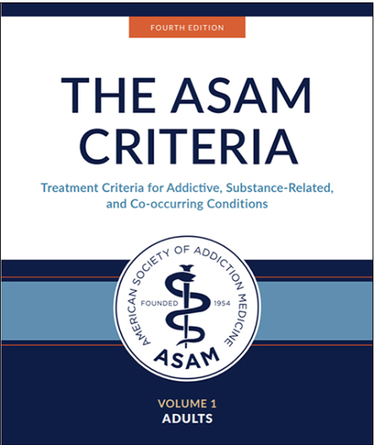
American Society of Addiction Medicine (ASAM)
4th Edition ASAM Criteria,
Chapter 19
Cognitive Impairment
“…cognitive impairment exacerbates barriers to care, complicates clinical management, and further limits treatment outcomes” (p. 457)

Slide 18
Neurologic-Informed Care
Address pronounced cognitive weakness as well as subtle weakness that may be misinterpreted by clinicians.
Results from a clinical staff trained to understand and recognize cognitive impairment and adapt treatment to accommodate those impairments.
Neurologic-informed care is not a specific substance disorder treatment modality – it is knowledge and skills that are applied to whatever treatment modalities a clinician employs.
Dr. Corrigan, Webinar June 6, 2024

Slide 19
Brain Injury Informed Peer Specialist Curriculum
NASHIA contracted by the Mountain Plains, Rural Opioid Technical Assistance Center
Develop a curriculum to ensure Certified Behavioral Health Peer Specialist are brain injury informed
To be piloted in the next two months
Web-based interactive facilitator guide to be developed by the end of September

Slide 20
Colorado Behavioral Health Practice Standards for Medicaid Recipients with TBI
Under no circumstance does the presence of TBI preclude an assessment for and treatment of cooccurring mental illness covered under the Colorado Medicaid Community Mental Health Services Program. BHOs will not deny services for a covered diagnosis on the basis that the covered diagnosis is not primary, and regardless of etiology.
A provider will complete a face-to-face assessment with any child, youth, or adult with TBI who is referred for evaluation for covered mental illness according to the provider’s regular intake and admission procedures and standards.

Slide 21
TBI and PTSD Law Enforcement Training Act
Legislative action with the passage of the Traumatic Brain Injury (TBI) and Post-Traumatic Stress Disorder Law Enforcement Training Act (H.R. 2992) in August 2022
Required Bureau of Justice Assistance (BJA) to develop training tools/resources focused on brain injury/PTSD for first responders
BJA requested a landscape review to lay the foundation for future work in this area. This was conducted by the Council on State Government with input from a variety of partners including NASHIA

Slide 22
Mind Matters Project Overview
Focus Groups & Interviews
Policy & Best Practices Review
Literature Review
Develop recommendations to address gaps in services and resources for the field to improve responses to people living with brain injury encountering the criminal justice (CJ) system.

Slide 23
Findings and Recommendations
Council on State Governments, 2024

Slide 24
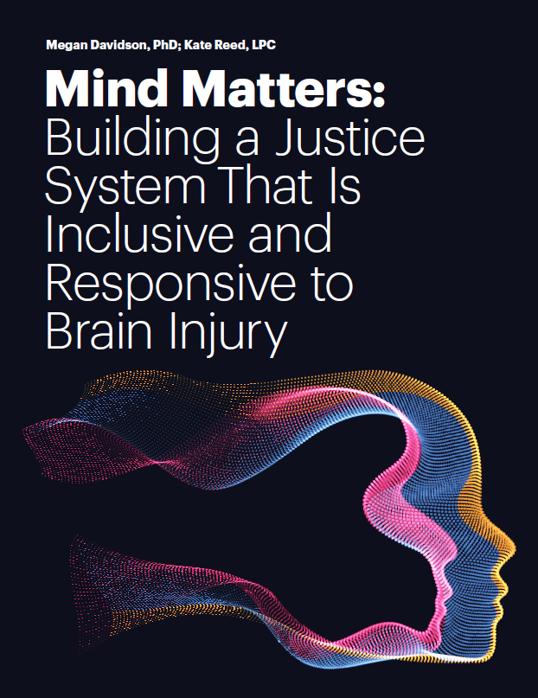
Report Released!
The Mind Matters report was published in June 2024 and can be accessed via the CSG Justice Center website.
Mind Matters: Building a Justice System That Is Inclusive and Responsive to People with Brain Injury
Council on State Governments, 2024

Slide 25
The Link Center
The Link Center works to improve supports available to children and adults with intellectual and developmental disabilities (I/DD), brain injuries, and other cognitive disabilities with co-occurring mental health conditions.
Maintains a library of trustworthy resources, models, and promising practices
Provides resources and technical assistance to assist state systems in developing policies and programs that support the provision of effective services and treatment
Develops and offers training to individuals with co-occurring disabilities and mental health conditions, family members, direct support professionals, clinicians, and other supporters
Promotes effective approaches to treatment and support
Fosters collaboration across disability and mental health services systems

Slide 27
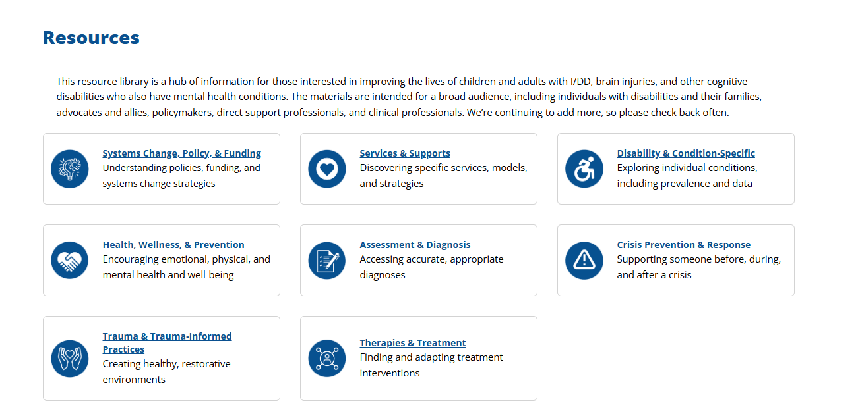

Slide 28
National Institutes of Health, National Institute of Neurological Disorders and Stroke (NINDS)
TBI Classification and Nomenclature

Slide 29
Why Explore Reclassification and Nomenclature
It was determined that the terms “mild”, “moderate”, and “severe” are outdated and imprecise. Kime P., Military.com, February 3, 2022
Mild is not always mild and severe is not always severe
Clinical severity lies along a continuum
Terms can lead to treatment bias
Patients and families do not like the use of these terms
Umoh N., NASHIA State of the States Conference, 9.17.24

Slide 30
Strategies for Supporting Brain Injury in Behavioral Health Settings

Slide 31
Tangible Solutions
01
02
03
04
05
Train on brain injury
Screen for brain injury
Screen for impairment
Adjust supports to address impairment
Refer to community supports

Slide 32
Importance of Screening: Lifetime History
42% of persons who indicated they had incurred a TBI as defined by the CDC did not seek medical attention (Corrigan & Bogner, 2007)
Research indicates that a person’s lifetime history of TBI is useful for judging current cognitive and emotional states, particularly behavior associated with the executive functioning of the frontal parts of the brain (e.g., planning, impulsivity, addiction, interpersonal abilities) Retrieved on 4/16/21: https://wexnermedical.osu.edu

Slide 33
NASHIA OBISSS
The OBISSS is an online screening system to determine the likelihood of brain injury and to identify associated challenges that may be present for youth and adults.
Benefit to the client:
identify TBI and non-TBI history
determine program eligibility
identify impairment and share strategies regarding the associated symptoms
provide strategies for professionals for how to support their client with a brain injury
NASHIA Online Brain Injury Screening and Support System
OBISSS

Slide 34
Importance of Screening for Impairment (1 of 2)
Just screening for lifetime history does not provide you information about current impairment
Understanding both the history of injury as well as current impairment allows for effective adjustments/accommodations to be implemented
Identifying the current impairment will help increase the persons ability to advocate for themselves

Slide 35
Importance of Screening Impairment (2 of 2)
Tiered Approach:
Self-report
Neuropsychological Screen
Neuropsychological Evaluation

Slide 36
Self-Report
Self-report is a good first step
Cautions: people with brain injury are not always to understand or see areas where they have challenges
Self-report provides a person-centered approach to support
Self-report can provide guidance on compensatory strategies

Slide 37
Neuropsychological Screen
When compensatory strategies are not working, consider going to the next tier, neuropsychological screen
Provides objective information on cognitive impairment
Can provide insight into other psychological concerns
Neuropsychological Screening Tools to consider include:
Automated Neuropsychological Assessment Metrics, Core Battery
Neuropsychological Assessment Battery – Screening Module
Repeatable Battery for the Assessment of Neuropsychological Status
More information about these screens can be found at this link and by clicking on “Neuropsychological Screening Batteries Chart”: Neuropsychological Screens

Slide 38
Neuropsychological Screening Course: Learn more here

Slide 39
The “So What”: Adjustments/Accommodating
Framework for Support
We are NOT treating the brain injury, we ARE treating the behavioral health concern in the context of brain injury.
Demystifies brain injury for non-brain injury professionals.
Empowers individuals with brain injury and families to advocate for appropriate supports.

Slide 40
The “So What”: Adjustments/Accommodating
Strategies should be easy to implement and appropriate to the environment
Strategies should be person centered; the person needs to be integral in:
1. Recognizing the need for a strategy
2. Developing a strategy
3. Monitoring progress

Slide 41
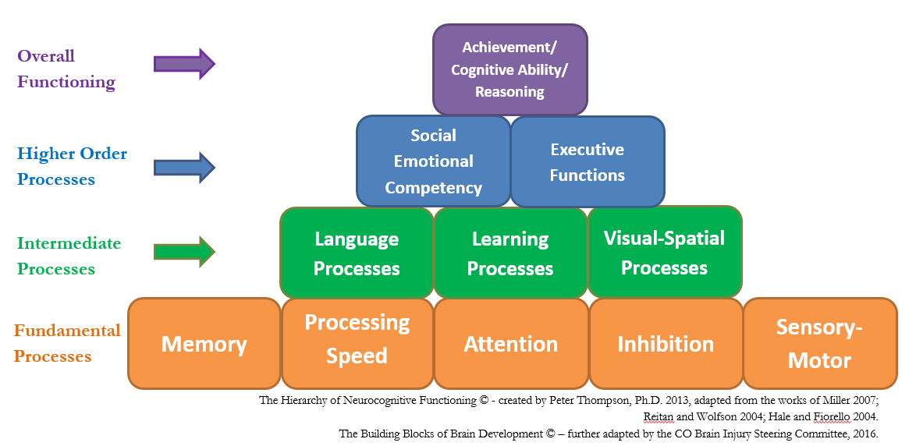
Building Blocks of Brain Development
https://cokidswithbraininjury.com/educators-and-professionals/brain-injury-matrix-guide/

Slide 42
Building Blocks of Brain Development
https://cokidswithbraininjury.com/educators-and-professionals/brain-injury-matrix-guide/

Slide 43
Attention
Achievement/ Cognitive Ability/ Reasoning
Social Emotional Competency
Executive Functions
Language Processes
Visual-Spatial Processes
Learning Processes
Memory
Processing
Speed
Inhibition
Sensory-Motor
https://cokidswithbraininjury.com/educators-and-professionals/brain-injury-matrix-guide/
Notes:
JD

Slide 44
The “So What”: Adjustments/Accommodating
Impaired Attention
What it looks like:
Fidget, squirms in seat, can’t sit still
Interrupts conversation
Talks excessively
Off topic
Impulsivity (inability to inhibit)

Slide 45
The “So What”: Adjustments/Accommodating
Impaired Attention
Adjustments/Accommodations:
Check to make sure you have the persons attention before giving instructions
Work on one task at a time to avoid the need to divide attention
Reduce distractions, meet in a quiet environment
Off topic
Keep instructions brief, simple and to the point

Slide 46
The “So What”: Adjustments/Accommodating
Short Term Memory Loss
What it looks like:
Can’t remember more than one thing at a time
Can’t remember details
Appears disorganized
Appears to have an “attitude” problem
Appears manipulative

Slide 47
The “So What”: Adjustments/Accommodating
Short Term Memory Loss
Adjustments/Accommodations:
Repeat and summarize information
Provide written summary
Review new information frequently
Stick to routine as much as possible
Keep information concise, tangible, and relevant

Slide 48
Skill vs Will (Can’t vs Won’t)
If think they have the skill but choose to not use it, likely to think punishment
If they think they don’t have the skill, less likely to think punishment, more likely to think of teaching the skill

Slide 49
Strategies to Assist with Functional Behavior
Doesn't feel rules are fair and expresses feelings inappropriately Expressive /Pragmatic Language
Teach appropriate ways to express verbal discontent
Is off-task while reviewing expectations:
Attention
Make sure you have attention before reviewing expectations
Can’t remember expectations:
Memory
Write out/draw out steps to compensate for memory

Slide 50
Strategies to Assist with Functional Behavior
Doesn't read visual cues: Visual-Spatial
May need to teach facial cues, non-verbal cues
Doesn't understand expectations: Receptive Language
Review expectations in visual, multi-modal fashion
May need to teach Cognitive Behavioral Therapy skills (CBT)
No problem-solving skills:
Executive Dysfunction

Slide 51
Resources

Slide 52
Useful BH Resources*
Accommodating the Symptoms of TBI
SAMHSA TBI and Substance Use Disorders
Client Workbook: Substance Use and BI 2nd Ed.
SAMHSA ATTC Network BH and BI Tip Card
SAMHSA Advisory: Treating Patients with TBI
ACL TBI-TARC Behavioral Health Guide
TBI MS Knowledge Translation Center: http://www.msktc.org/tbi/factsheets
Emotional Problems and TBI
Depression and TBI
Rocky Mountain MIRECC for Veteran Suicide Prevention
*All can be found at nashia.org

Slide 53
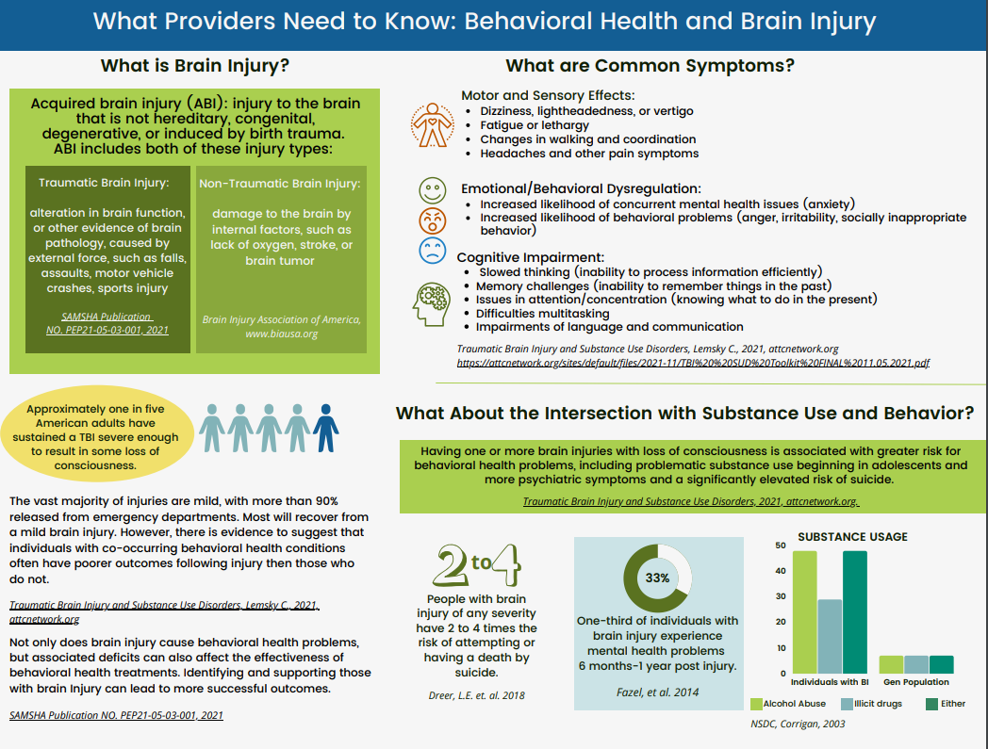
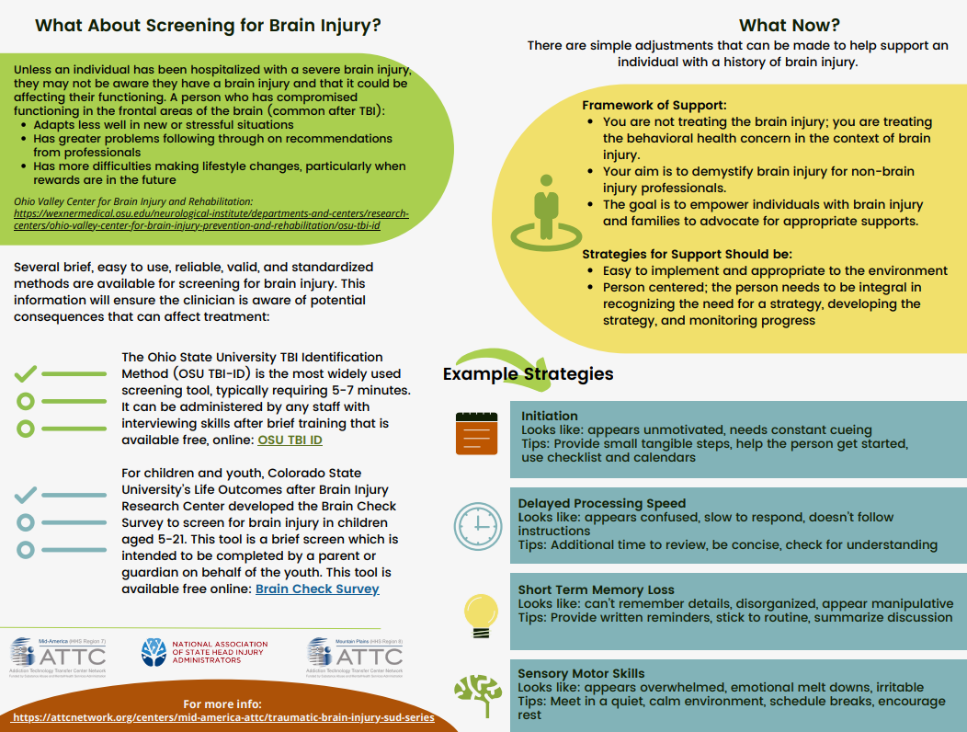
BH and BI Tip Card

Slide 54
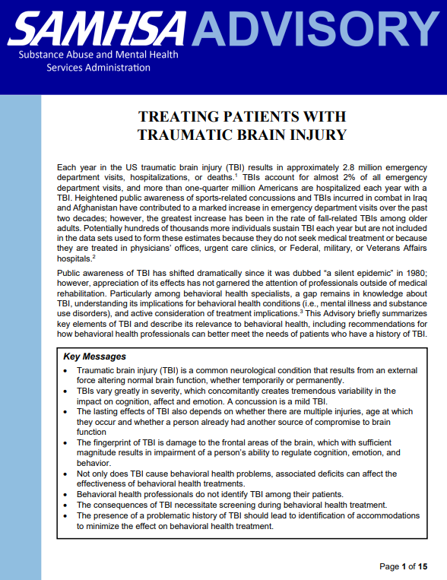
SAMHSA Advisory: Treating Patients With TBI

Slide 55
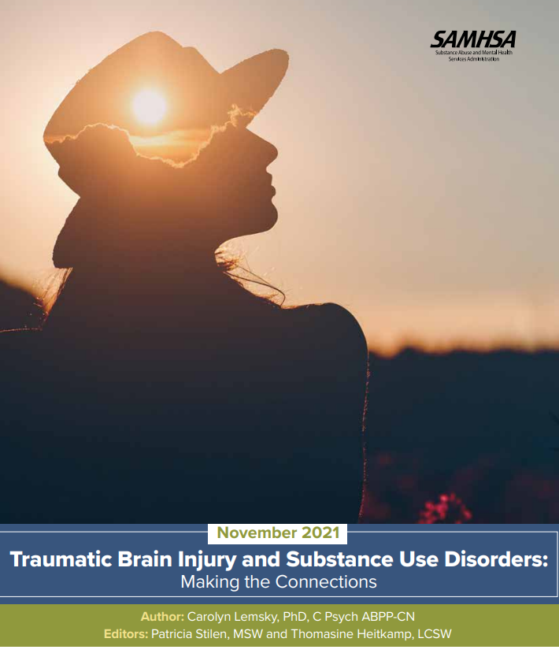
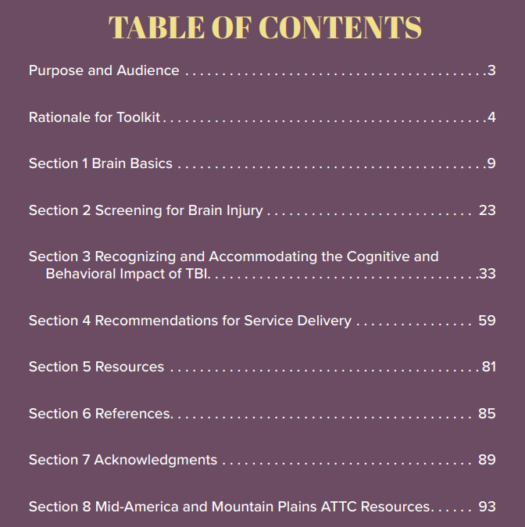
Addictions Toolkit

Slide 56
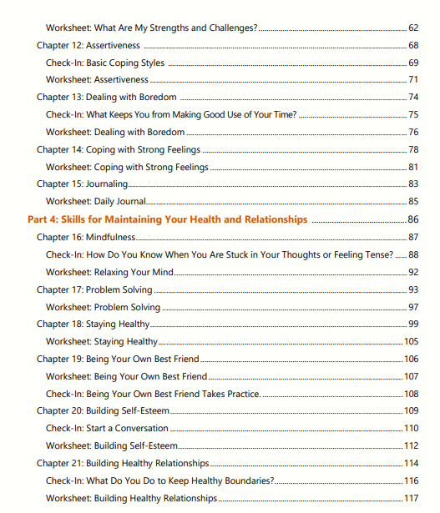
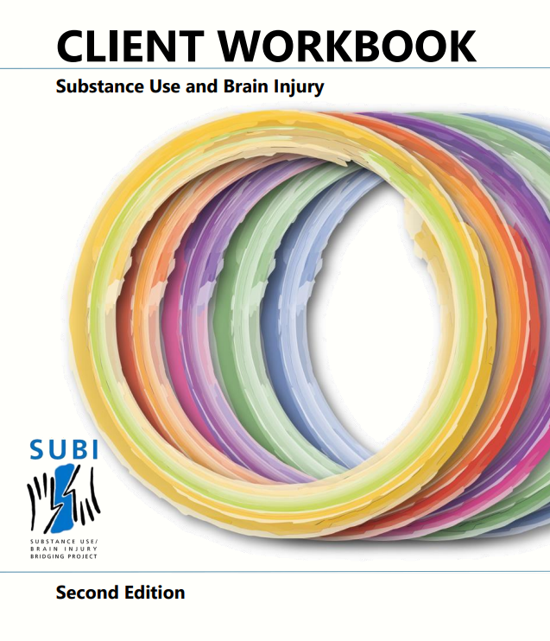
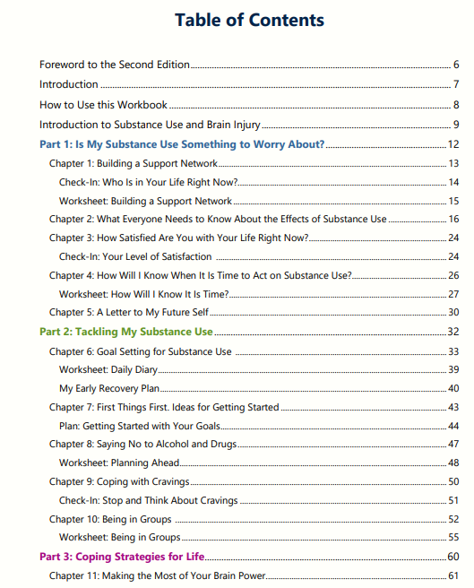
SUBI 2 Workbook

Slide 57
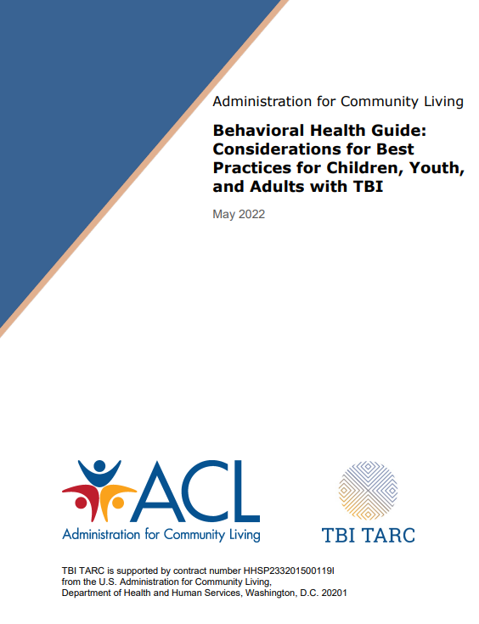
TBI TARC BH Guide
How to better partner with state mental health systems
Training approaches
Screening approaches
Modifying clinical interventions**
Modifying psychopharmacologic interventions**
**Chapter Briefs

Slide 58
National Organizations/ Websites to Know
National Association of State Head Injury Administrators
National Disability Rights Network
NIDILRR TBI Model Systems Knowledge Translation Center
Brain Injury Association of America
Centers for Disease Control and Prevention
Brainline

Slide 59
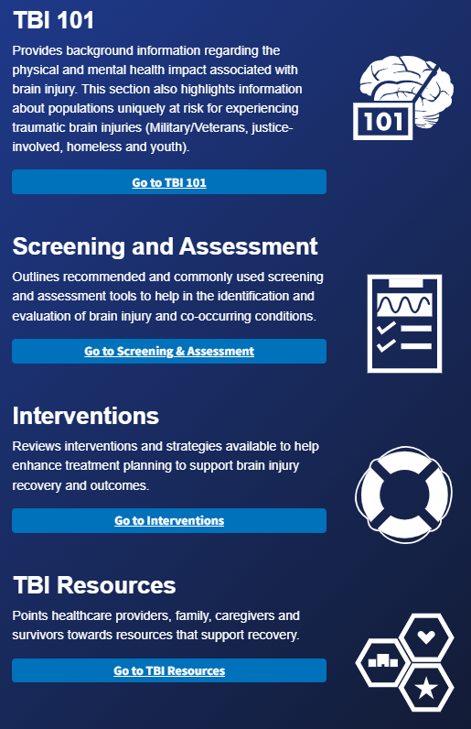
Rocky Mountain MIRECC – TBI Toolkit
Mental Health and Brain Injury Toolkit

Slide 60
Registration opens April 1 and Sponsor Opportunities available now!
Notes:
Zaida

Slide 61
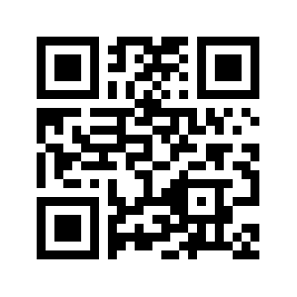
Join our Email List!
Notes:
Zaida

Slide 62
Join NASHIA!
Individual and Group Memberships
Save on Training and Certificates of Attendance
Access to National Member Directory
Networking Meetings
info@nashia.org

Slide 63
Thank you!
If you have any questions,
you are welcome to contact me.
Judy Dettmer
Director for Technical Assistance
and Special Projects
jdettmer@nashia.org

Slide 64
Let’s stay in touch!
nashia.org

Slide 65
References
Kureshi N, Clarke DB, Feng C. Association between traumatic brain injury and mental health care utilization: evidence from the Canadian Community Health Survey. Inj Epidemiol. 2023 Mar 13;10(1):16. doi: 10.1186/s40621-023-00424-x. PMID: 36915175; PMCID: PMC10012583.
McHugo GJ, Krassenbaum S, Donley S, Corrigan JD, Bogner J, Drake RE. The Prevalence of Traumatic Brain Injury Among People With Co-Occurring Mental Health and Substance Use Disorders. J Head Trauma Rehabil. 2017 May/Jun;32(3):E65-E74. doi: 10.1097/HTR.0000000000000249. PMID: 27455436.
Corrigan, J. D., Bogner, J., & Holloman, C. (2012). Lifetime history of traumatic brain injury among persons with substance use disorders. Brain Injury, 26(2), 139–150. https://doi.org/10.3109/02699052.2 011.648705
Ahmed, S., Venigalla, H., Mekala, H. M., Dar, S., Hassan, M., & Ayub, S. (2017). Traumatic brain injury iInjury and Neuropsychiatric Complications. Indian Journal of Psychological Medicine, 39(2), 114–121. https://doi.org/10.4103/0253-7176.203129
Cuthbert, J. P., Harrison-Felix, C., Corrigan, J. D., Kreider, S., Bell, J. M., Coronado, V. G., & Whiteneck, G. G. (2015). Epidemiology of adults receiving acute inpatient rehabilitation for a primary diagnosis of traumatic brain injury in the United States. The Journal of Head Trauma Rehabilitation, 30(2), 122–135. https://doi.org/10.1097/HTR.0000000000000012
Corrigan, J. D., Bogner, J., & Holloman, C. (2012). Lifetime history of traumatic brain injury among persons with substance use disorders. Brain Injury, 26(2), 139–150. https://doi.org/10.3109/02699052.2 011.648705

Slide 66
References
Kornblith ES, Yaffe K, Langa KM, Gardner RC. Prevalence of Lifetime History of Traumatic Brain Injury among Older Male Veterans Compared with Civilians: A Nationally Representative Study. J Neurotrauma. 2020 Dec 15;37(24):2680-2685. doi: 10.1089/neu.2020.7062. Epub 2020 Aug 26. PMID: 32762279; PMCID: PMC7869884.
Massaad E, Kiapour A. Long-Term Health Outcomes of Traumatic Brain Injury in Veterans. JAMA Netw Open. 2024;7(2):e2354546. doi:10.1001/jamanetworkopen.2023.54546
Toccalino D, Haag HL, Estrella MJ, Cowle S, Fuselli P, Ellis MJ, Gargaro J, Colantonio A; and the COVID TBI-IPV Consortium. The Intersection of Intimate Partner Violence and Traumatic Brain Injury: Findings From an Emergency Summit Addressing System-Level Changes to Better Support Women Survivors. J Head Trauma Rehabil. 2022 Jan-Feb 01;37(1):E20-E29. doi: 10.1097/HTR.0000000000000743. PMID: 34985037.
Hwang SW, Colantonio A, Chiu S, Tolomiczenko G, Kiss A, Cowan L, Redelmeier DA, Levinson W. The effect of traumatic brain injury on the health of homeless people. CMAJ. 2008 Oct 7;179(8):779-84. doi: 10.1503/cmaj.080341. PMID: 18838453; PMCID: PMC2553875.
Eric J. Shiroma, Pamela L. Ferguson, and E. Elisabeth Pickelsimer, “Prevalence of Traumatic Brain Injury in an Offender Population: A Meta-Analysis,” Journal of Correctional Health Care 16, no. 2 (2010):147-159, https://doi.org/10.1177/1078345809356538.
Jonathan M. Silver et al., “The Association between Head Injuries and Psychiatric Disorders: Findings from the New Haven NIMH Epidemiologic Catchment Area Study,” Brain Injury 15, no. 11 (2001): 935-945, https://doi.org/10.1080/02699050110065295.
Kristi Wall et al., “Violence-Related Traumatic Brain Injury in Justice-Involved Women,” Criminal Justice and Behavior 45, no. 10 (2018): 1588-1605, https://doi-org.du.idm.oclc. org/10.1177/0093854818778082.

Slide 67
References
Jonathan M. Silver et al., “The Association between Head Injuries and Psychiatric Disorders: Findings from the New Haven NIMH Epidemiologic Catchment Area Study,” Brain Injury 15, no. 11 (2001): 935-945, https://doi.org/10.1080/02699050110065295.
Kristi Wall et al., “Violence-Related Traumatic Brain Injury in Justice-Involved Women,” Criminal Justice and Behavior 45, no. 10 (2018): 1588-1605, https://doi-org.du.idm.oclc. org/10.1177/0093854818778082.
Adams RS, Corrigan JD, Dams-O'Connor K. Opioid Use among Individuals with Traumatic Brain Injury: A Perfect Storm? J Neurotrauma. 2020 Jan 1;37(1):211-216. doi: 10.1089/neu.2019.6451. Epub 2019 Aug 16. PMID: 31333067; PMCID: PMC7364315.
Kumar RG, Ornstein KA, Corrigan JD, Sayko Adams R, Dams-O'Connor K. Association between Lifetime History of Traumatic Brain Injury, Prescription Opioid Use, and Persistent Pain: A Nationally Representative Study. J Neurotrauma. 2021 Aug 15;38(16):2284-2290. doi: 10.1089/neu.2020.7496. Epub 2021 Mar 11. PMID: 33567980; PMCID: PMC8672103.

