Slide 1
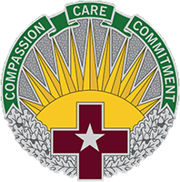
Treatment for Clients with Traumatic Brain Injury
Intrepid Spirit Center
CDR Selena Bobula, PT, DPT
CDR Steven Spoonemore, PT, DPT, DSc
LT Devon Barbieri, OTR/L
Ms. Caitlyn Razzano, MA, ATR-P
“Quality Assurance Document under 10 USC § 1102. Copies of this document, enclosure thereto and information there from will not be further released under penalty of the law. Unauthorized disclosure carries a statutory penalty of not more than $3,000 in the case of a first offense and not more than $20,000 in the case of a subsequent offense. In addition to these statutory penalties, unauthorized disclosure may lead to unfavorable actions under the UCMJ and/or adverse administrative action, including separation from military or civilian service.”

Slide 2
Outline
Introduction to the Intrepid Spirit Center – Fort Carson – CDR Bobula
Research Interests - CDR Spoonemore
Intensive Outpatient Programming – LT Barbieri
Creative Arts Therapies and Case Examples – Ms. Razzano

Slide 3
Disclosure
Conflict of Interests: None
The views expressed in this presentation are those of the authors and do not reflect the official policy of the Department of the Army, Department of Defense, Defense Health Agency, or the U.S. Government
No relevant financial relationships exist

Slide 4
Objectives
Define Traumatic Brain Injury (TBI) services available across the military setting
Explore the research mission & focus of the Defense Intrepid Network (DIN) & Traumatic Brain Injury Center of Excellence (TBICoE)
Describe the interdisciplinary treatment program at the Intrepid Spirit Center – Fort Carson (ISC)
Share unique cases & Art Therapy services provided at the ISC

Slide 5
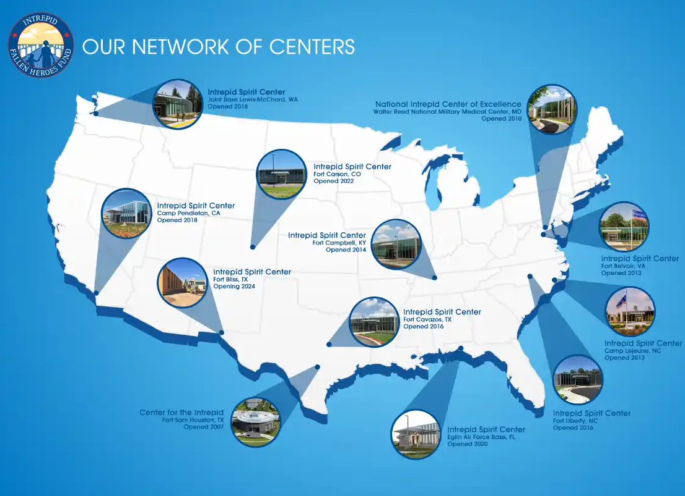

Slide 6
Intrepid Spirit Center Mission
DIN Mission: To improve the lives of patients and families impacted by TBI through integrated clinical practice, research, and education.
DIN Vision: To be the global leading network for TBI and brain health clinical care, research, and education for military members and beneficiaries.
Fort Carson: One of 10 regional ISC’s in the DIN

Slide 7
Intrepid Spirit Center – Fort Carson Goals
Develop short- and long-term strategies
Symptom management
Health maintenance
Balanced lifestyle
Recover
Activities of daily living
Occupational tasks
Leisure pursuits
Learn management strategies
Physical
Emotional
Social
Intellectual
Functional
Spiritual
Facilitate support from family/friends
Improve self efficacy:
Reduce reliance on healthcare professionals
Self manage health and wellness techniques
Demonstrate functional improvement
Appropriate outcome measures
Process improvement
Research

Slide 8
Additional ISC and DIN Background
Defense Intrepid Network for TBI and Brain Health
Clinical Programs | Clinical Services and Specialties
TBI Outpatient Program*/** – A program that provides diagnostic evaluation, treatment, diagnoses, and follow-up care for TBI of all severities. Patients work with providers and case managers to get personalized outpatient rehabilitation services, symptom management, and treatment plans. Intensive Outpatient Program (IOP) */** – A multi-week program for patients diagnosed with TBI and associated health conditions. Tailored treatment plans are created with patient, family, and provider input that focus on the mind, body, and spirit. Patients learn self-management skills to increase resilience, manage symptoms, and enhance their long-term well-being. TBI Inpatient Consultation***– Inpatient consultation for MEDEVAC and Acquired Brain Injury (ABI). Acute Concussion Clinic**– As defined in DHA-PI 6490.04, “Required Clinical Tools and Procedures for the Assessment and Clinical Management of Mild Traumatic Brain Injury (mTBI)/Concussion in Non-Deployed Setting,” dated 26 April 2021. | Behavioral Health Services Neuropsychology Psychiatry Psychology Social Work Medical Services Neurology Neuro-optometry Primary Care Sports Medicine Rehabilitation Services Audiology Nutrition Occupational Therapy Physical Therapy Physiatry Pain Management Speech-Language Pathology | Integrative Medicine Services Animal Assisted Therapy Creative Arts Therapies Mind-Body Wellness Spiritual Wellness Clinical Support Services Advanced Diagnostics & Testing Brain Fitness Center Nursing Case Management Referral Management TBI Portal for Clinical Care Management TBI Education and Training

Slide 9
Intrepid Spirit Center at Fort Carson, CO
Medical services:
Neurology
PM&R
Behavioral Health:
Neuropsychology
Art Therapy
Music Therapy
Rehabilitation Services:
PT
OT
SLP
Advanced Nurse Case Management
NeuroOptometry
Other procedures provided in clinic:
Xeomin/Botox injections, Occipital Nerve Blocks, etc for headaches
Transcranial Magnetic Stimulation
Battlefield (Auricular) Acupuncture

Slide 10
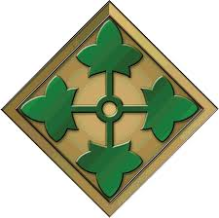
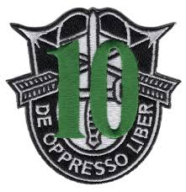
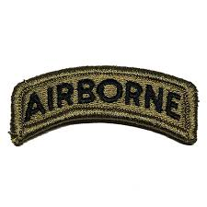
Population
Active Duty (priority), Adult Dependents, and Retirees
History of a head injury or brain insult
Wide variety (mild - severe, single - multiple)
Co-morbid conditions
Chronic pain
Sleep disturbances
PTS, PTSD, Anxiety, Depression

Slide 11
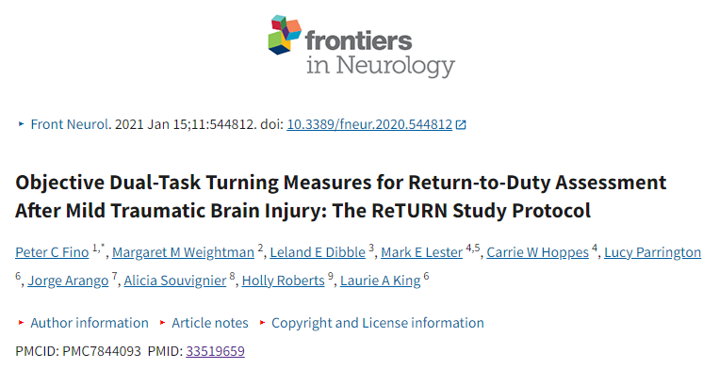
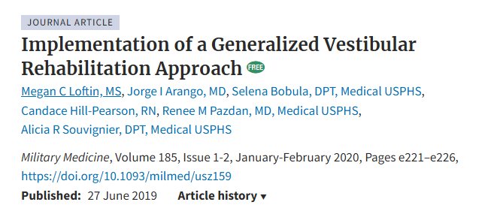
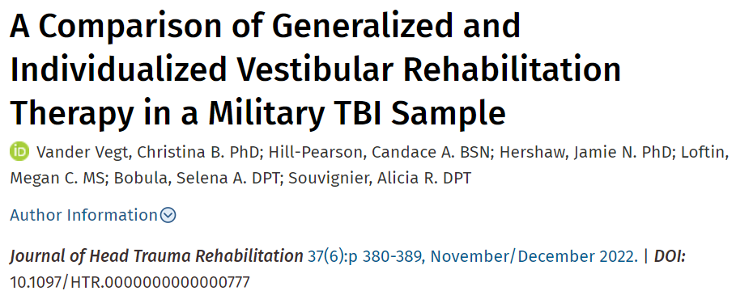
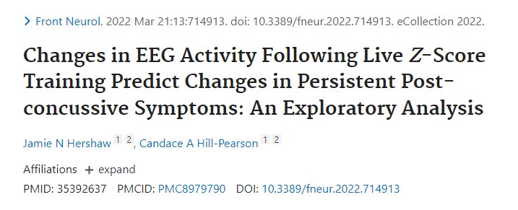
Published Peer Review Research
Partnership with TBICoE (n=9)
OHSU ReTURN: Objective Dual-Task Turning Measures for RTD Assessment (n=1)
Generalized Vestibular Rehabilitation Approach (n=3)
Warrior Strong: Military & Civilian Lifetime History of TBI & Associated Disabilities: The Tale of two Population (n=1)
Telemedicine and Advanced Technology Research Center: Neurofeedback (n=4)

Slide 12
Additional Research & Partnerships
Partnership with TBICoE (n=43 presentations)
U of Pittsbugh: Randomized Control Trial of Precision Vestibular Rehabilitation in Military Populations (TREV); (n=13)
Resilience, Autonomic Dysfunction, and Risk in TBI (RADAR); (n=4)
Cognitive Pupillometric Assessment of Acute Mild TBI: Identifying Non-Invasive Biomarkers of Injury Severity and Prognosis; (n=3)

Slide 13
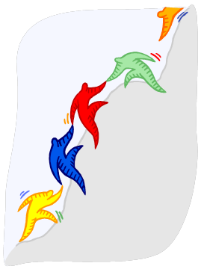
Integrated Outpatient Rehabilitation Program (iROC) Intensive Outpatient Program (IOP)
Multi-disciplinary instruction
4 days weekly x 6 weeks
Maximum of 8 clients per cohort
Provide training in a variety of skills
Improve quality of life
Address symptoms

Slide 14
IOP Design

Slide 15
Community Outings
Objective: Improve community reintegration
Social-Communication Skills
Anxiety/ Stress/ Anger regulation
Mindfulness skills
Executive functions
Problem Solving

Slide 16
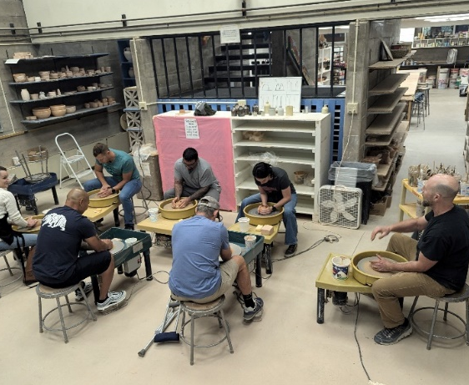
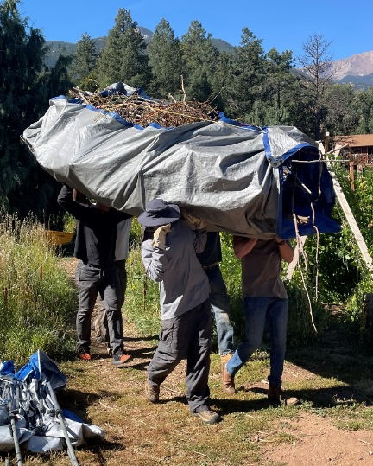
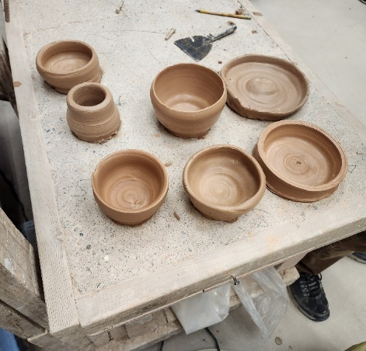
Community Partners
US Air Force Academy Re-Med
Habitat for Humanity
COS Community Gardens
Colorado College & Fine Arts Center
Concrete Couch

Slide 17
IOP Outcomes
TBI Symptoms
Peer Learning and Support
Readiness for Change
Transfer of Skills

Slide 18
Art Therapy
is the therapeutic use of art for health, provided by an art therapist.
An integrative mental health and human services profession that enriches the lives of individuals, families, and communities through active art- making, creative process, applied psychological theory, and human experience within a psychotherapeutic relationship.
-American Art Therapy Association
master's level or higher mental health clinicians
counseling & trauma-care skills
offer specific art media, techniques, art education
developmental, cultural, & psychological needs
facilitate patients’ understanding of their art’s personal symbolic or metaphorical meaning
increase insight and self-discovery
national certification: ATR-P, ATR, or ATR-BC
state licensure AT or LPC

Slide 19
Art Therapy Addresses:
Psychological
Emotional regulation & anxiety reduction
Stress reduction/management
Wellbeing, positive emotions, leisure, & relaxation
Identity/insight
Trauma Processing *
Spiritual
Processing grief & loss
Moral injury
Inspiration & self-expression
Sense of meaning & purpose in life
Physical
Dexterity, fine motor skills, & eye-hand coordination
Vision
Sensory Integration
Pain*
Social
Challenges of isolation & disconnection
Interpersonal communication
Empathy
Neurological
Memory
Attention / concentration / focus
Higher functional connectivity

Slide 20
Cultural Considerations
Deployment-related trauma
Stigma of seeking help
Living in a state of survival
Unique community and connectedness
Group-oriented, not individual focused
Lack of autonomy
Maintain a façade of unbothered and tough
Givers/helpers
Perfectionism

Slide 21
Art Therapy Services
Directive | Goals
Mask-making | identity development self-expression
wood-burning/drawing/watercolor Mandalas | stress reduction emotional regulation flow
Gelli Printing | self-expression positive emotions
Printmaking Self-symbols | self-expression identity development
Needle-felting | emotional regulation flow
Bookmaking | communication creating connections meaning-making
Pour Painting | emotional regulation frustration tolerance Positive emotions
Mantra Stones | moving forward discharging
Individual sessions
Group sessions (IOP)
Do not have to have prior art experience
Focus is on the process not the final product
Assessment during individual intake: Bridge with Path Drawing
Artmaking is implemented within each session or group for processing, grounding, and working on goals
Short-term or long-term art pieces

Slide 22
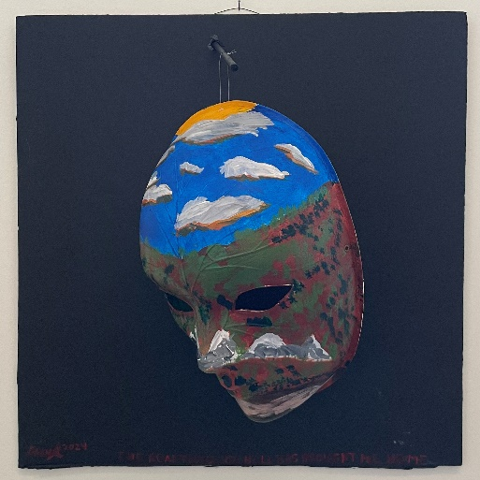
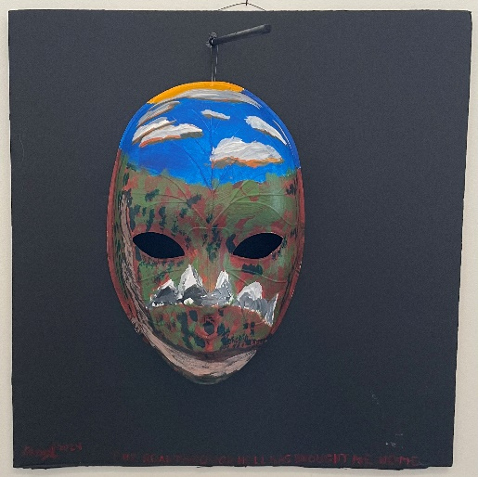
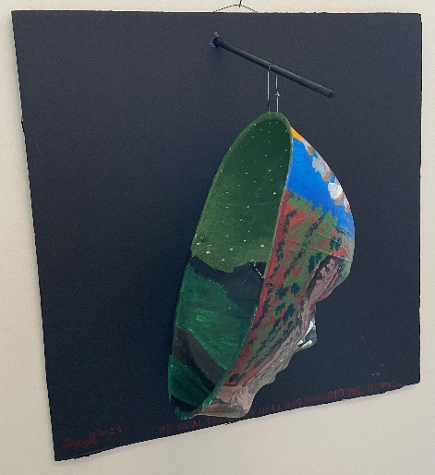
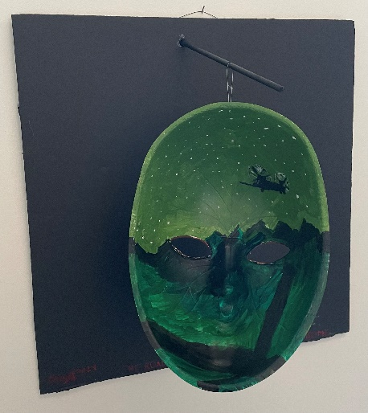
Art Therapy Case Study 1
“The road through hell has brought me home.”

Slide 23
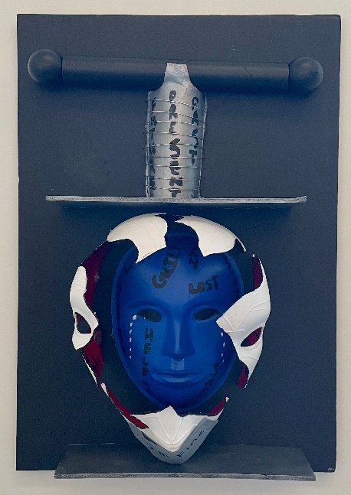
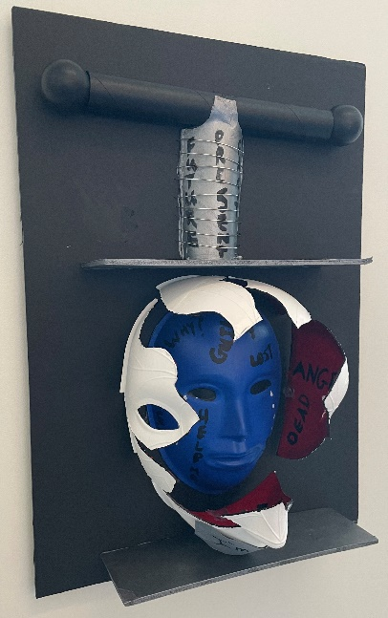
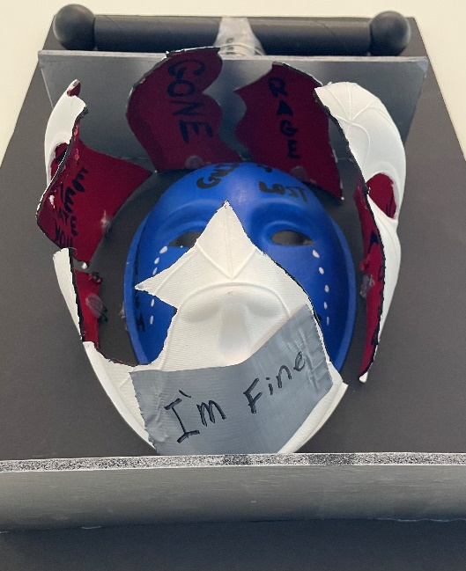
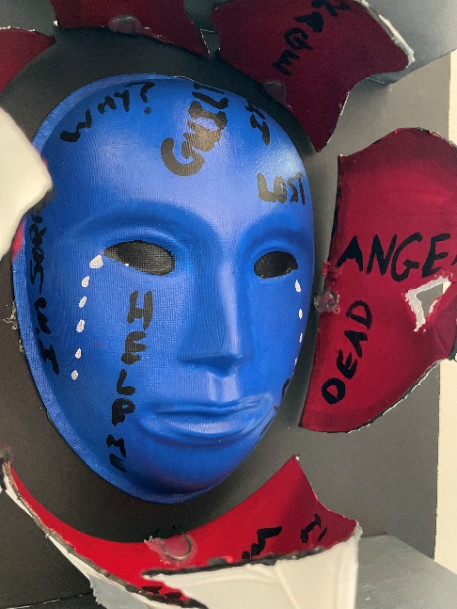
Art Therapy Case Study 2

Slide 25
QUESTIONS

Slide 26
References
DeGraba TJ, Williams K, Koffman R, Bell JL, Pettit W, Kelly JP, Dittmer TA, Nussbaum G, Grammer G, Bleiberg J, French LM, Pickett TC. Efficacy of an Interdisciplinary Intensive Outpatient Program in Treating Combat-Related Traumatic Brain Injury and Psychological Health Conditions. Front Neurol. 2021 Jan 18;11:580182. doi: 10.3389/fneur.2020.580182. PMID: 33536993; PMCID: PMC7848806.
Kinney AR, Adams RS, Caban JJ, DeGraba TJ, Pickett T, Hoover P. Intensive Outpatient Program Response Among Service Members With Mild Traumatic Brain Injury: Change Between Distinct Post-Concussive Symptom Subgroups. Arch Phys Med Rehabil. 2023 Jun;104(6):892-901. doi: 10.1016/j.apmr.2022.12.191. Epub 2023 Jan 11. PMID: 36639092.
Janak JC, Cooper DB, Bowles AO, Alamgir AH, Cooper SP, Gabriel KP, Pérez A, Orman JA. Completion of Multidisciplinary Treatment for Persistent Postconcussive Symptoms Is Associated With Reduced Symptom Burden. J Head Trauma Rehabil. 2017 Jan/Feb;32(1):1-15. doi: 10.1097/HTR.0000000000000202. PMID: 26709579.
Jones, J. P., Drass, J. M., & Kaimal, G. (2019). Art therapy for military service members with post-traumatic stress and traumatic brain injury: Three case reports highlighting trajectories of treatment and recovery. The Arts in Psychotherapy, 63, 18-30. https://doi.org/10.1016/j.aip.2019.04.004.
Jones, J. P., Walker, M. S., Drass, J. M., & Kaimal, G. (2018). Art therapy interventions for active duty military service members with post-traumatic stress disorder and traumatic brain injury. International Journal of Art Therapy, 23(2), 70–85. https://doi.org/10.1080/17454832.2017.1388263
Walker, M. S., Kaimal, G., Gonzaga, A. M., Myers-Coffman, K. A., & DeGraba, T. J. (2017). Active-duty military service members’ visual representations of PTSD and TBI in masks. 26 International Journal of Qualitative Studies on Health and Well-Being, 12(1), 1267317. https://doi.org/10.1080/17482631.2016.1267317
Walker, M. S., Kaimal, G., Koffman, R., & DeGraba, T. J. (2016). Art therapy for PTSD and TBI: A senior active duty military service member’s therapeutic journey. The Arts in Psychotherapy, 49, 10–18. https://doi.org/10.1016/j.aip.2016.05.015

